Slide 1
STRATEGIC
TRANSFORMATION
PLAN
From Denim
Category Leader
to Lifestyle Brand
The "Denim Lifestyle" Pivot
Levi Strauss & Co. · $50M Investment · May 2026
BUAN 6390 — Analytics Practicum

Slide 2

Levi's Today: FY2025 Snapshot
A position of genuine strength — entering transformation from solid ground
$6.28B
61.7%
$3.07B
+22%
Net Revenue
+7% organic growth
Gross Margin
Record high FY2025
DTC Revenue
+11% YoY
E-Commerce
Q4 growth
CEO Michelle Gass has committed to a DTC-first, head-to-toe denim lifestyle strategy.
This report is the strategic operational plan that executes that commitment.
The foundation is strong. The opportunity now is to deepen it.
Source: Levi's Q4 FY2025 Earnings Release & SEC 8-K filings

Slide 3

Three Structural Friction Points
What's holding Levi's back from full lifestyle brand capture
01
The Cross-Sell Barrier
Deep trust in bottoms doesn't yet extend to tops.
Customers complete outfits outside Levi's — limiting AOV and DTC effectiveness.
02
Inventory Risk
Only ~60% of apparel inventory sells at full price industry-wide.
Expanding into lifestyle SKUs without improved forecasting threatens the record 61.7% gross margin Levi's has spent two years defending.
03
The Agility Gap
Levi's design-to-shelf cycle: 12–16 weeks.
Social trends (TikTok/Instagram) emerge, peak and fade in 6–9 weeks.
By the time a trend-aligned product reaches the floor, the moment has already passed.

Slide 4

Three Coordinated Initiatives
A $50M investment portfolio — each targeted, collectively transformative
Personalized Recommendation Engine | $15M
P1
Addresses: Cross-sell barrier
AI-Aided Apparel Design | $20M
P2
Addresses: Agility gap + inventory risk
Licensed Capsule Collaborations (F1 / McLaren) | $10M
P3
Addresses: Inventory risk + brand relevance
+ $5M Contingency Reserve (unallocated — deployment-triggered)
$50M total investment - conservative base-case projections

Slide 5

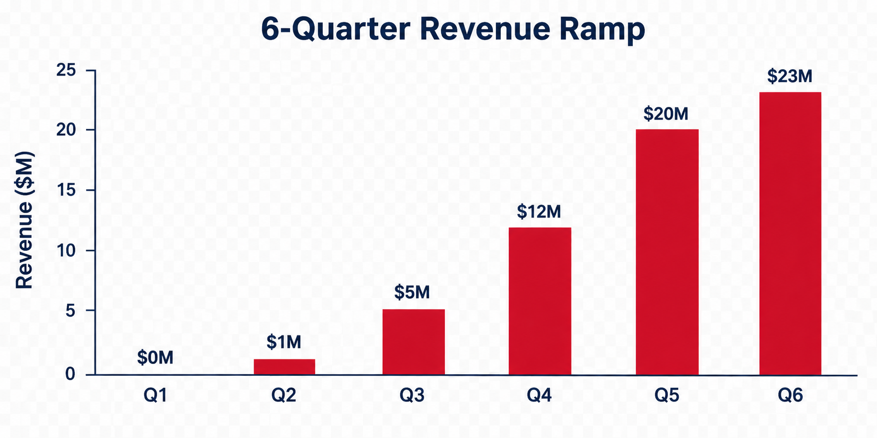
P1 · Personalized Recommendation Engine
$15M — Directly addresses the cross-sell barrier
Core Engine Dev
~$7M
Red Tab + BackPocket + capsule signal stack
Social Trend Layer
~$5M
Heuritech + Brandwatch real-time regional signals
Platform Integration
~$3M
Levi.com, app, shop-in-shop, Microsoft Super-Agent
6-Quarter Revenue Ramp (Conservative 2% DTC lift)
Payback: 9–12 months after ramp | 6Q Total: ~$61M incremental revenue
Conservative 2% DTC lift - well below McKinsey 5-15% industry range

Slide 6

P2 · AI-Aided Apparel Design
$20M — Closes the agility gap and reduces inventory risk
BEFORE
AFTER
12–16 week
design cycle
Physical sampling high cost & time
No real-time feedback
20–25% cycle compression
3D virtual sampling (CLO 3D / Browzwear)
Demand signals feed design
Sampling Cost Savings
~$7–10M/yr
Sell-Through Improvement
+2pp → ~$9M GP
Net Annual Benefit
~$14M
Payback: 24–30 months (conservative) | Also partially self-funds P3 capsule program

Slide 7

P3 · Licensed Capsule Collaborations
$10M Pilot — F1 / McLaren anchor. Already proven. Now scaling.
Formula 1 × Levi's: Perfect Demographic Overlap
827M
43%
42%
40%
Global F1 fans
+63% since 2018
F1 fans under 35
57% of all new fans
Female audience
3 of 4 new fans are women
Gen Z more likely to
buy from F1 partners
Revenue Scenarios — Year 1 Pilot (41,000 units, $3.6M gross sales)
Upside
Base
Downside
Sell-through: 95%
Rev: $3.06M | Margin: 41.8%
Sell-through: 90%
Rev: $2.69M | Margin: 31.5%
Sell-through: 70%
Rev: $1.72M | Margin: 3.2%
Even the downside barely breaks even — bounded risk by design.

Slide 8
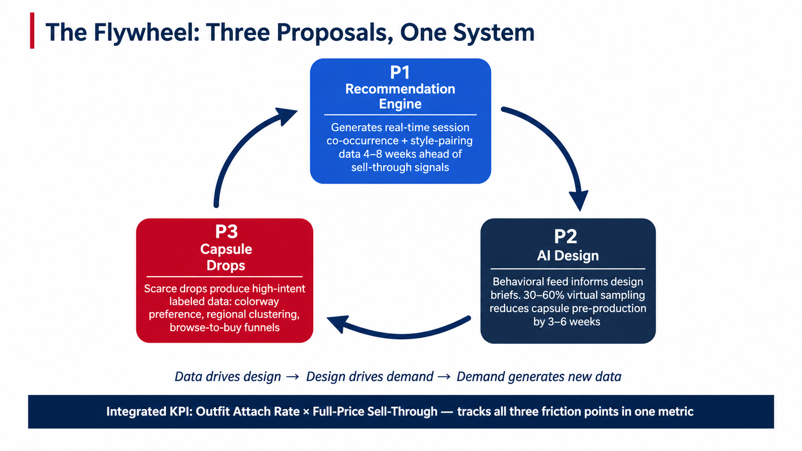

Slide 9

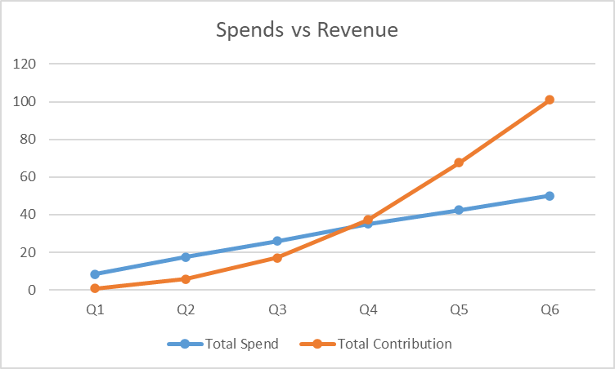
6-Quarter Financial Model
Conservative base-case — J-curve trajectory to cumulative cash-positive at Q4
~$70–80M
~$18M
~$50–60M
Q4
6Q Revenue
Contribution
Sampling
Cost Savings
Net Program
Contribution
Cash-Positive
Quarter
Cumulative Net P&L — The J-Curve ($M)
 | Q1 | Q2 | Q3 | Q4 | Q5 | Q6
Quarterly Contribution | 1 | 5 | 11 | 20 | 30 | 33
Quarterly Spend | 8.5 | 9.0 | 8.5 | 9.0 | 7.5 | 7.5
Net Quarterly | (7.5) | (4.0) | 2.5 | 11.0 | 22.5 | 25.5
Cumulative Net | (7.5) | (11.5) | (9.0) | 2.0 ✓ | 24.5 | 50.0
Stress test: If all assumptions miss by 20% simultaneously → still ~$34M net. Asymmetric risk-return profile.

Slide 10
Thank You
"Levi's does not need more
inventory — it needs more
intelligent inventory."
Prepared by — Group 7
Pralay Rajkumar Patil
Neehar Omkar Phatak
Manyata Agrawal
Investment Scale: $50,000,000
Program Window: 6 Quarters
Target Net Contribution: ~$50–60M
Sanjay Dilip
Akshay Vijay Kulkarni
BUAN 6390 — Analytics Practicum · May 2026

